Slide 1


University of Padova
Department of Information Engineering
ChillApp
Maria Lorena Morelli, Lorenzo Cester
Course of Biomedical Wearable Technologies for Healthcare and Wellbeing
A.Y. 2021-2022

Slide 2
Background
Yoga plus regular care was effective in reducing symptoms of depression compared with regular care alone. Further investigation is warranted regarding potential benefits in anxiety. Individualized yoga may be particularly beneficial in mental health care in the broader community. [de Manincor, Michael, et al.]
Physical activity and yoga practice have been shown to elicit improvements in anxiety and depression symptoms conducting to a better social, physical, and affective well-being optimizing the pharmacological treatment duration and the risk of pharmacological adverse side effects. [D'Alessio, Luciana, et al.]

Slide 3
Feature to be provided to the public

Slide 4
Our solution

Slide 5
Core app functionalities Screen Map
Heart Data Page
Activity Data Page
Activity Settings Page
login
authorize
Sleep Data Page
Login Page
Authorization Page
Home Page
Yoga Page
Flower Page
logout
Profile Page

Slide 6
Core app functionalities User authentication and management
The user must go through a (fake) login procedure, if not already logged in, by inserting a valid username and the correspondent password.
If the inserted credentials are correct, the username is saved in the Database (DB), using SharedPreferences.
When starting the app, the DB is queried and if no username is present, the login page is shown, otherwise the homepage is visualized.
When the user logs out, the stored username is deleted.

Slide 7
Core app functionalities User authorization and management
Once logged in, the user must authorize (otherwise they cannot go on). Before doing that, an informative message is shown.
If the authorization goes successfully, the ciphered Fitbit user ID is saved in the DB, using SharedPreferences, in order to be used to fetch data.
If the user is logged in but the refresh token is expired, there is the possibility for the user to authorize again, in the data visualization pages and in the yoga page.
When the user logs out, the stored user ID is deleted and the method unauthorize() of FitbitConnector is used.

Slide 8
Core app functionalities Data collection and persistence
Immediately after the login, if the user authorizes, an initial fetch of a (possibly) large quantity of data is done. Then, the collected data are saved in the local DB.
The rest of the data can be fetched on a daily basis: if no data are present in the local storage for the selected day, they are fetched from Fitbit, then saved in the DB (otherwise they are fetched directly from the DB). This is true for the data visualization pages and the yoga page.
As for the flower-growth-by-steps page and the profile page, the needed data are always fetched from the DB.
The local most recent activity and heart data are possibly partial. In order to be kept up to date, they are deleted from the DB. This is done when they are referred to a past day and, only for the activity data, also if the selected day is the current one, with a maximum frequency of 1/15 min⁻¹.
When the user logs out, all the locally stored data are deleted. Before doing that, an informative message is shown.

Slide 9
Core app functionalities Data collection and persistence
Data persistence with Floor
Account(id, name, dateOfBirth, gender, height, weight, legalTermsAcceptRequired, avatar);
Activity(id, date, type, distance, duration, startTime, calories);
ActivityTimeseries(date, steps, floors, minutesSedentary, minutesLightly, minutesFairly, minutesVery);
Heart(date, restingHR, minimumOutOfRange, minutesOutOfRange, minimumFatBurn, minutesFatBurn, minimumCardio, minutesCardio, minimumPeak, minutesPeak);
Sleep(id, date, entryDateTime, level);
Data persistence with SharedPreferences
KEY | ‘username’ | ‘userID’ | ‘counter’ | ‘pastTime’ | ‘pastTimeActivity’ | steps | floors
TYPE | String | String | int | int | int | int | int

Slide 10
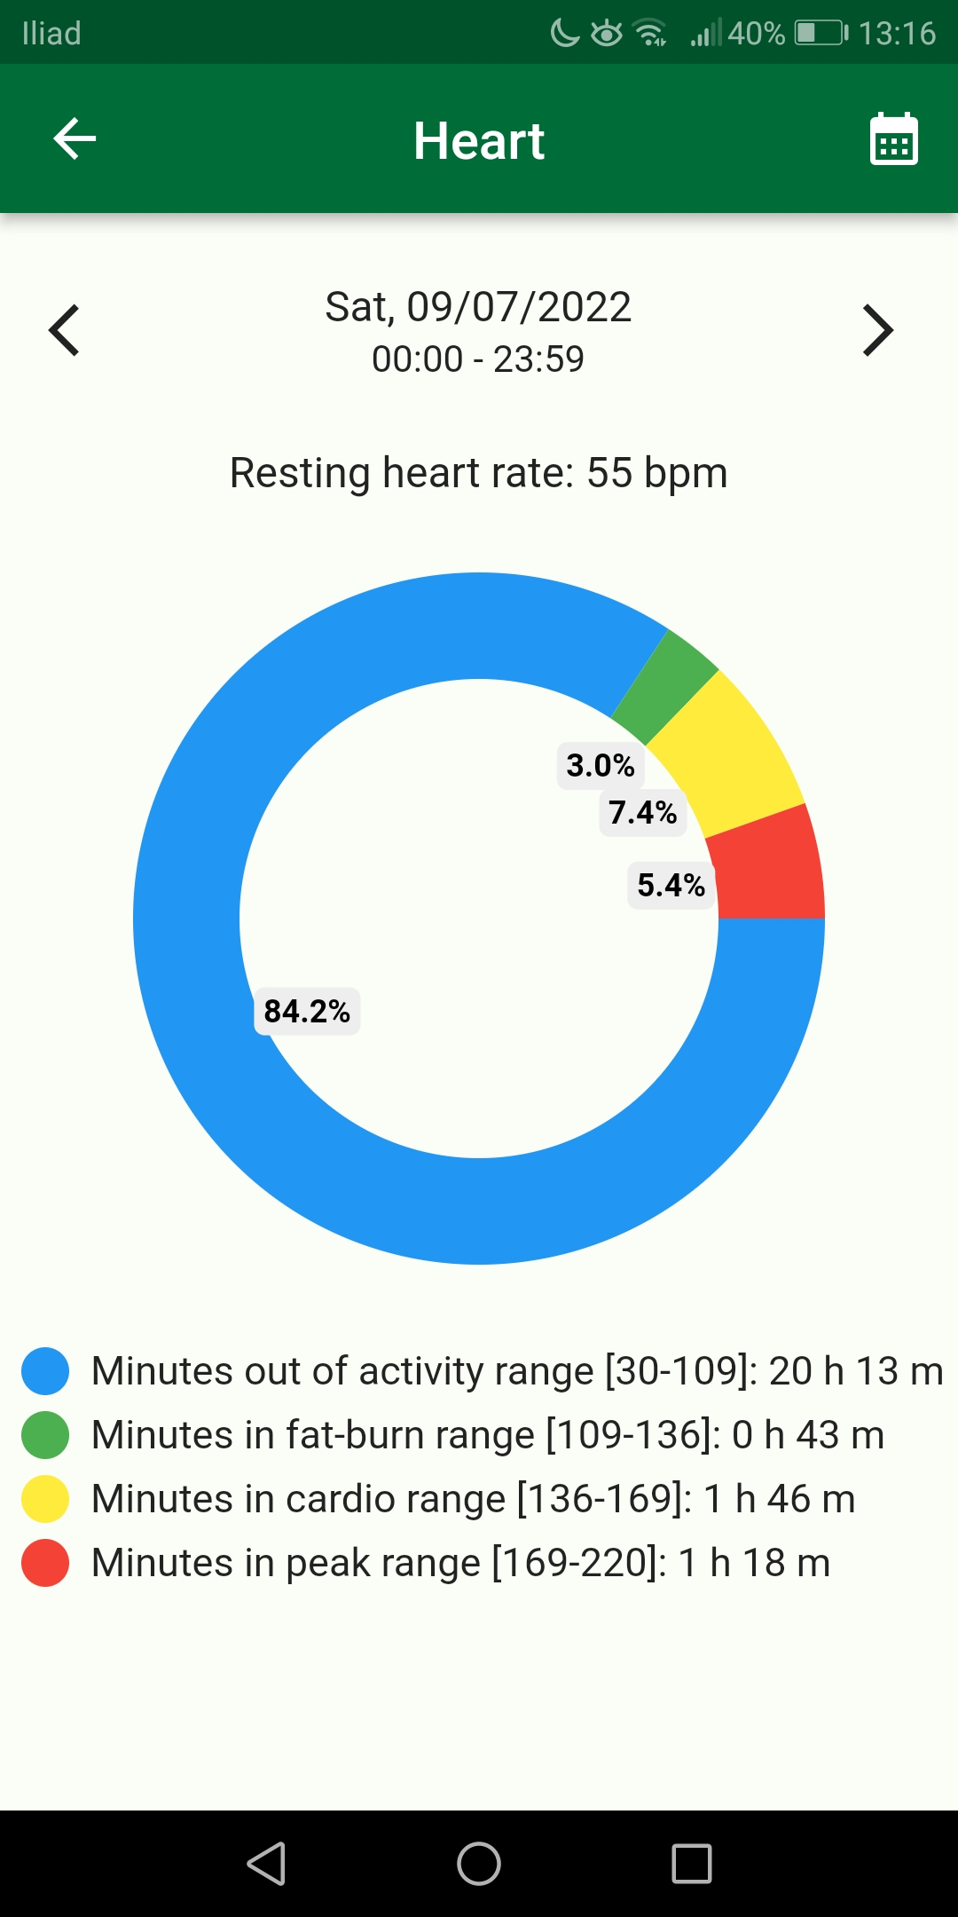
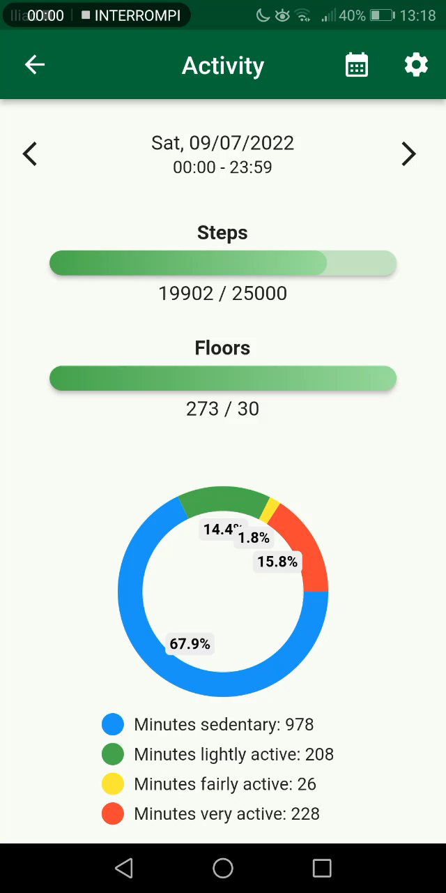
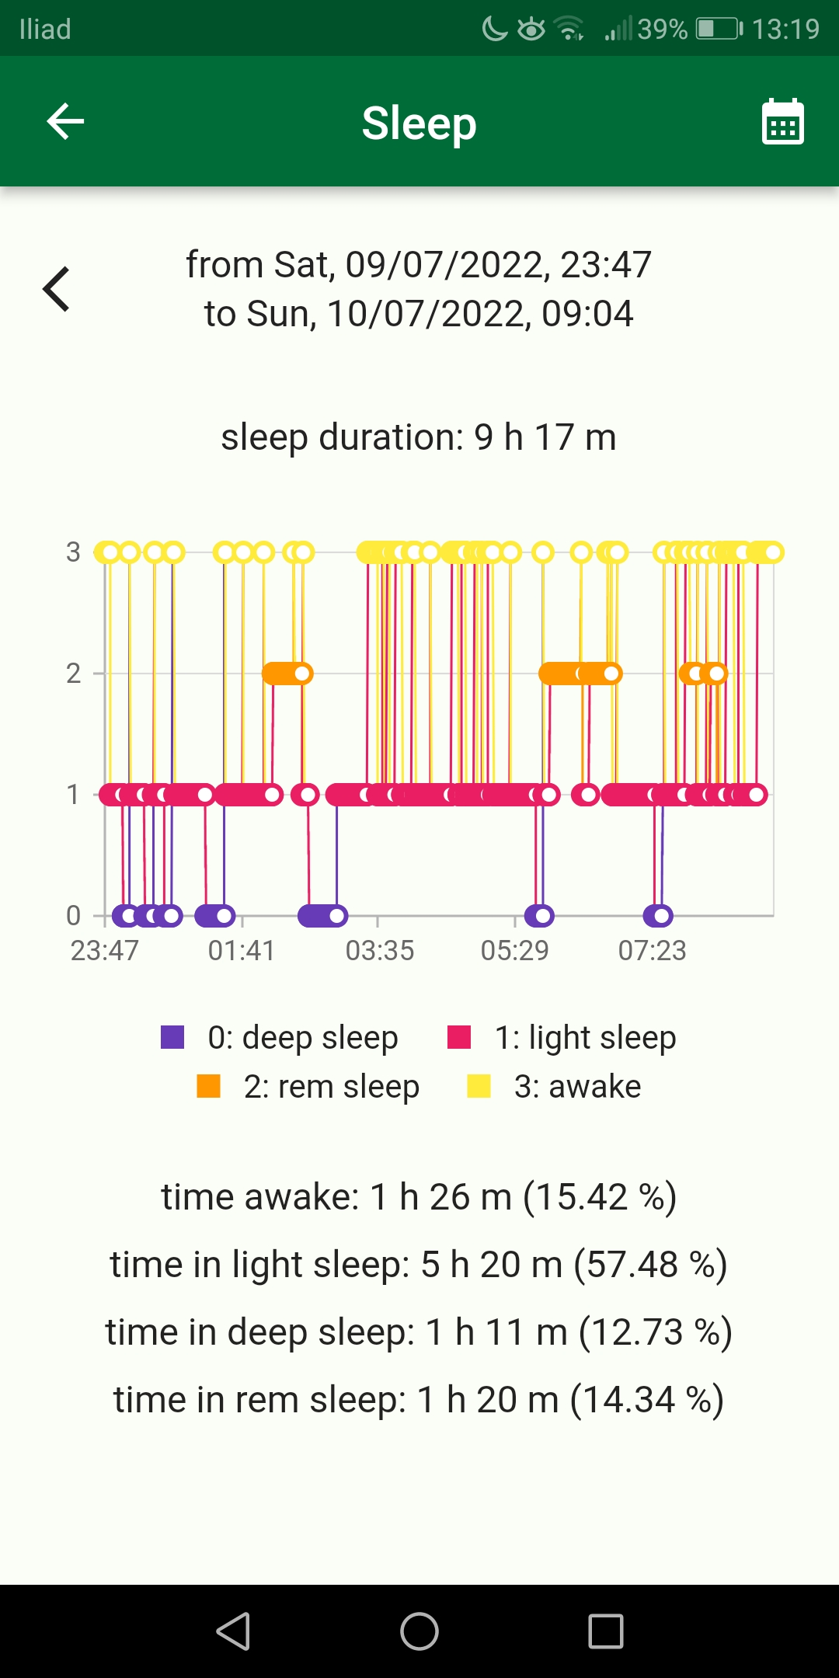
Core app functionalities Data visualization
Heart data
Activity data
Sleep data

Slide 11
Original features Yoga and flower-growth-by-steps

Slide 12
Project management flavours

Slide 13
Special implementations isTokenValid
Two main problems are the refresh token expiring and the presence of a limit rate of queries that can be done to the Fitbit resource server (150 per hour).
In order to investigate whether the refresh token is still valid or not, before doing any fetch, the method isTokenValid() of FitbitConnector is used.
If it returns false, a button to go through the authorization procedure again is shown, in the data visualization pages.

Slide 14
Special implementations QueriesCounter
In order to avoid to exceed the limit rate of queries, the function check() of the singleton QueriesCounter is used.
The core of this method are the two variables pastTime and counter, which are saved in the DB with SharedPreferences. They take into account of the time when a query is done and the number of queries executed, respectively.
counter is incremented of 1 unit every time a query is done. Only when a query is performed and at least one hour has passed, counter is reset (to 1) and pastTime is updated.
The elapsed time is retrieved by comparing pastTime and the current time (when a query is done).
If counter is smaller than the maximum rate of queries, check() returns false, otherwise true. If true is returned, no more queries can be done, until counter resets, and a message reporting that is shown, in the data visualization pages.
Differently from the other data present in the DB, counter and pastTime are not deleted once the user logs out.

Slide 15
Compliance with the GDPR
Lawfulness, fairness and transparency: the processing is sufficiently transparent and, since allowed by the user’s consent, also lawful. ✓
Purpose limitation: the purposes of the processing are clear from the start. ✓
Data minimization: only the needed data are used and stored in the DB. ✓
Accuracy: the data are kept up to date. ✓
Storage limitation: assuming that the user possibly could be not interested in visualizing too old data, more compliance with this principle could be got limiting the period of storaging (e.g. to one year).
Integrity and confidentiality: the integrity of data is ensured, since they are saved on the Fitbit resource server and they could be fetched from there anyway, while the security of data not, since the stored data are not ciphered.
Accountability ✓

Slide 16
Future developments
Presence of the sign up and the possibility to have more users logged in at the same time.
Possibility for the user to save their favourites yoga positions.
To make the very old data to be deleted from the DB, in order to get more compliance with the storage limitation principle of the GDPR.
When starting the app, to do a single fetch of (possibly all) the data referred to the period of time from the most recent day in the Database to the current day, if that period of time is large (e.g. one month), for each type of data. This could be helpful to avoid more the problem coming from the presence of a limit rate of queries.
To implement cryptography for the locally stored data.
Updating for the account data (with low frequency, e.g. once a year)
If possible, to add a method to fetch FitbitActivityData for more days with a single query.

Slide 17
Live demo

